Slide 1


Slide 2


AmiCare
Second Year
Submitted by
ROLL | NAME
2501010168 | Harsh Dev Jha
2501010153 | Ishan Rawat
2501010096 | Hrijul Bharadwaj
2501010033 | Akshay Kumar
2501010144 | Anvesha Saxena
Dr. Pinky Kumari
Faculty Mentor:
Notes:
New Courses replaced with New Programmes
2

Slide 3


Slide 4
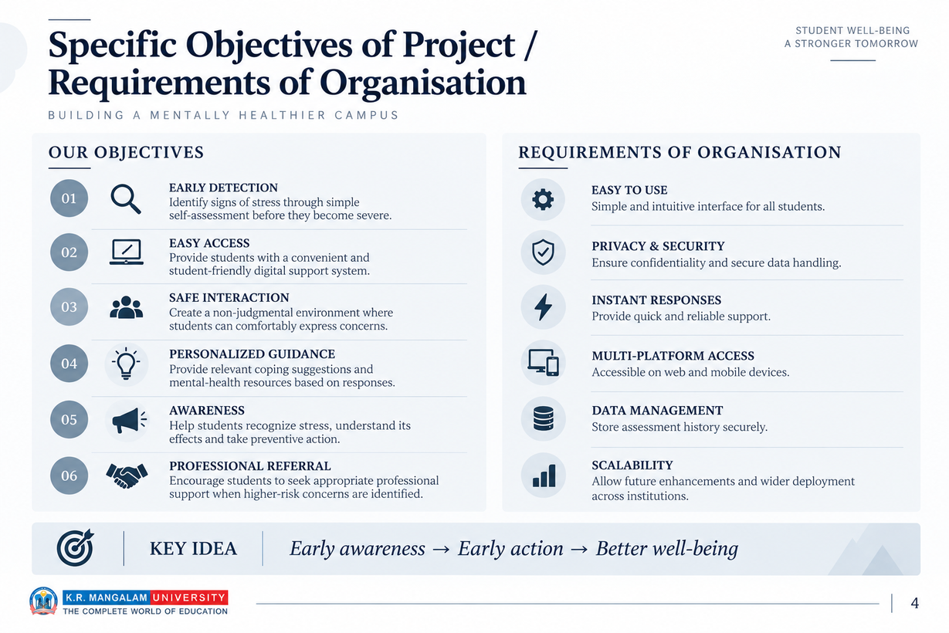

Slide 5


Slide 6
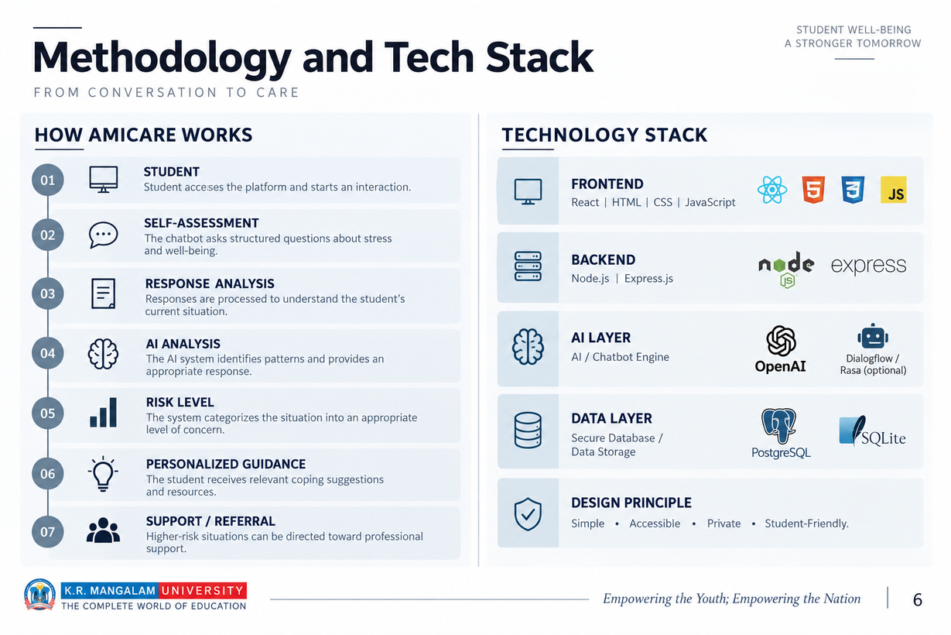

Slide 7
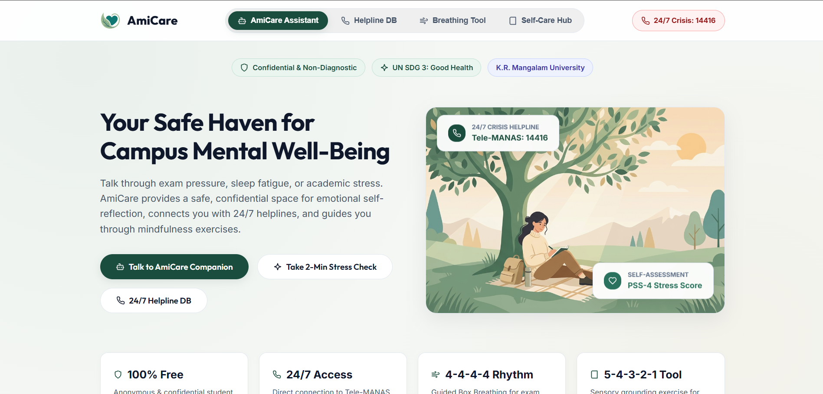
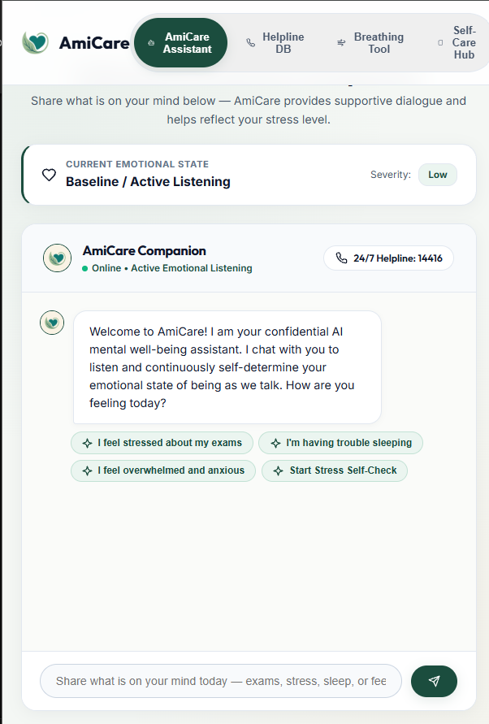


Prototype/Project Flow diagram/Architecture
Notes:
New Courses replaced with New Programmes

Slide 8
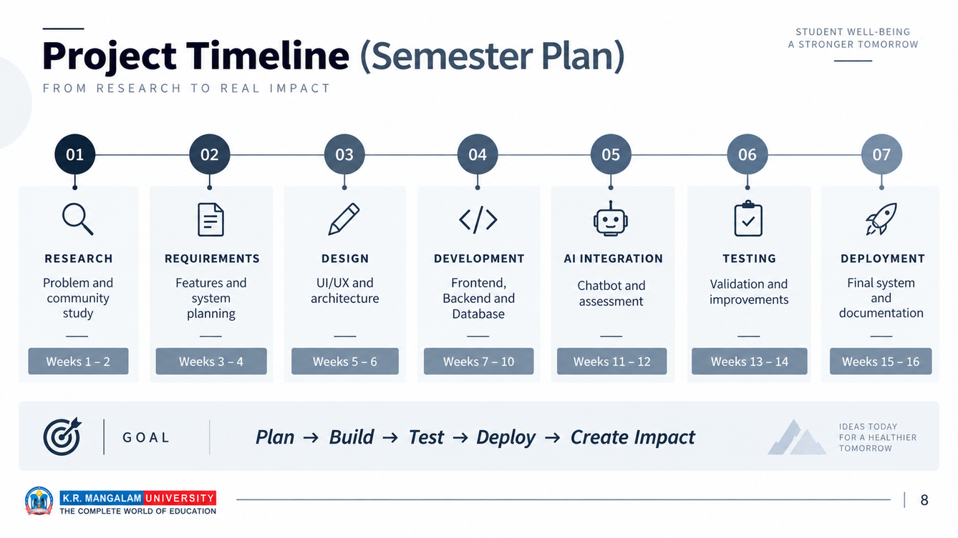

Slide 9
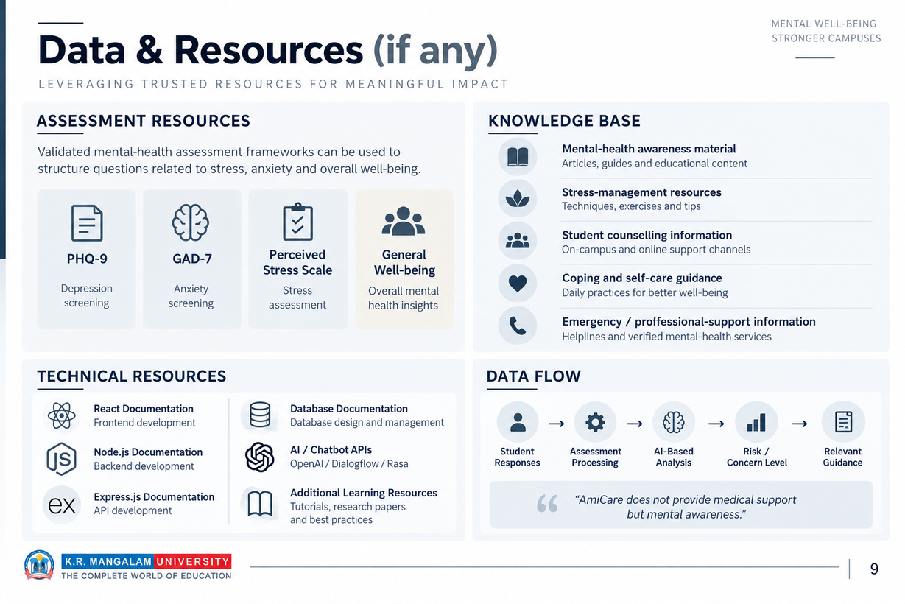

Slide 10
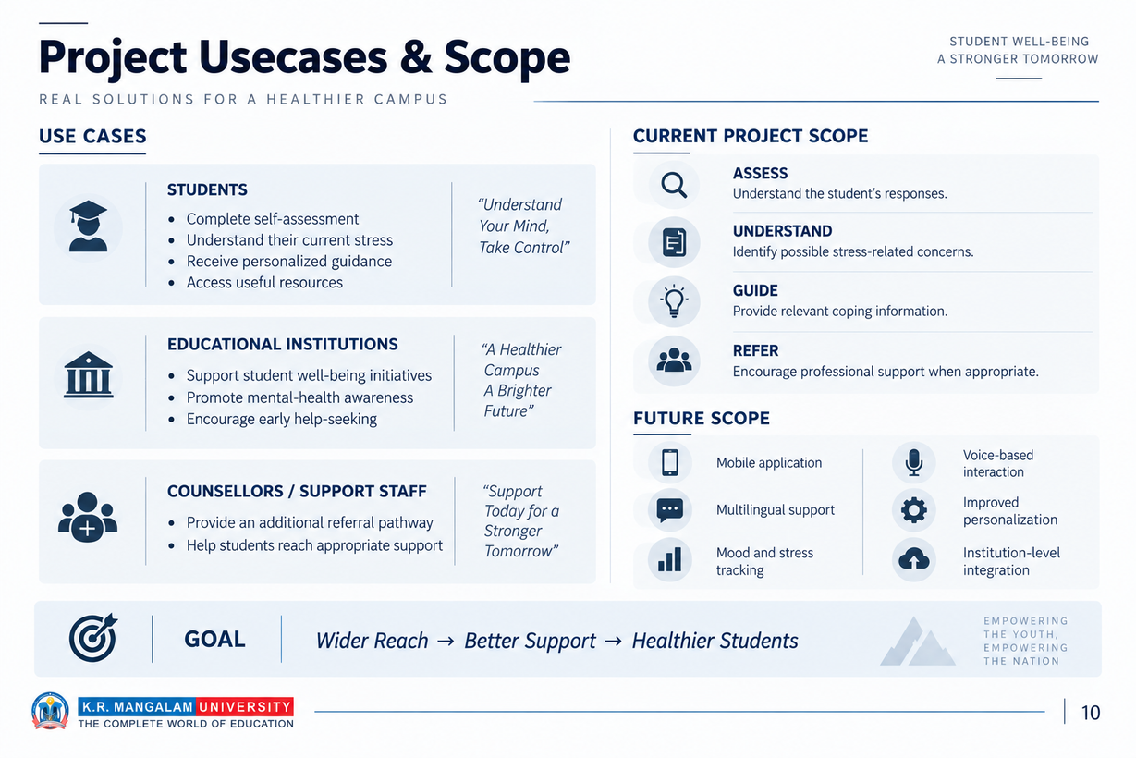

Slide 11
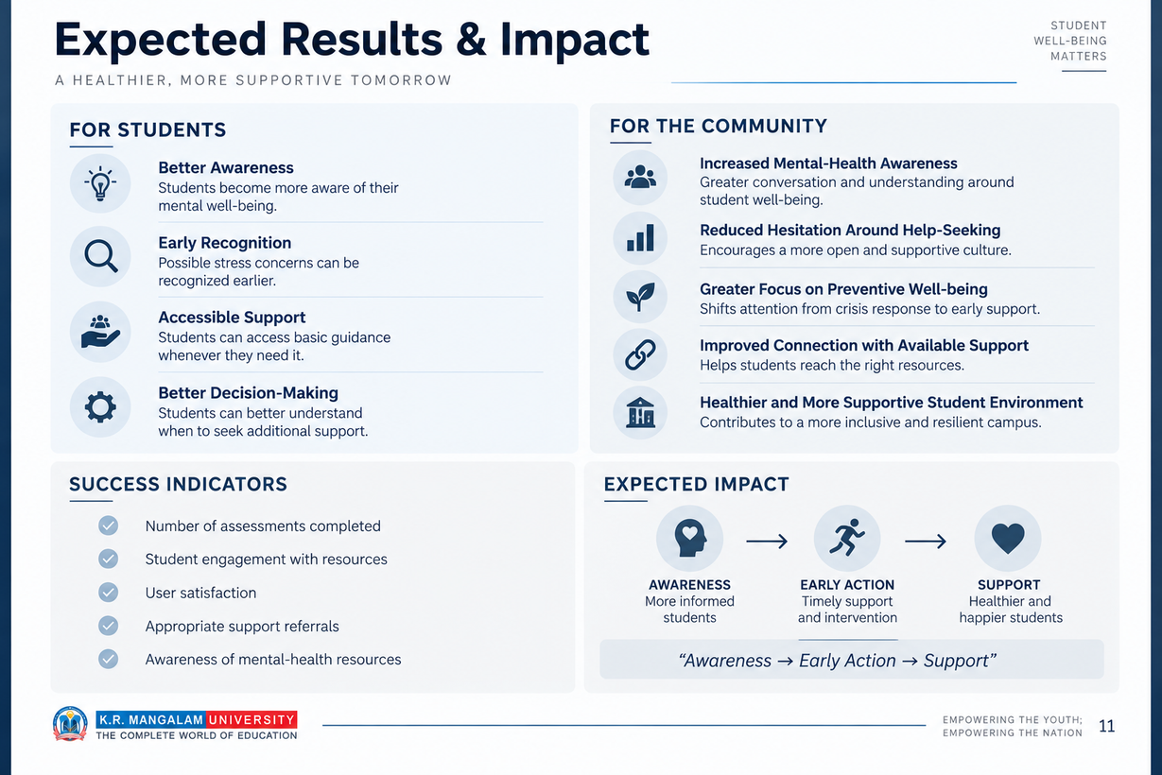

Slide 12

THANK YOU

